Slide 1
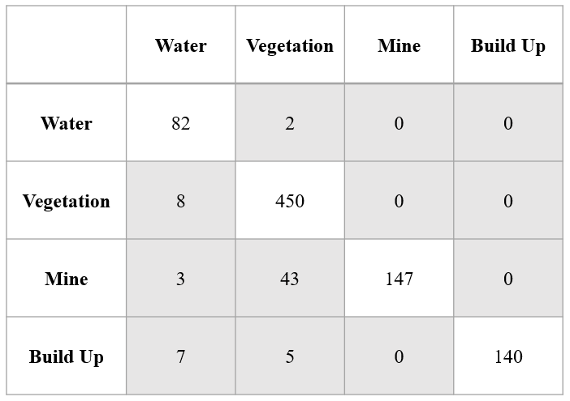
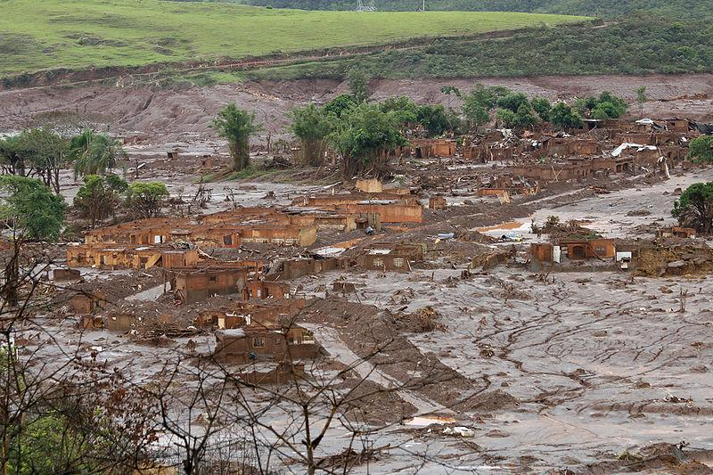
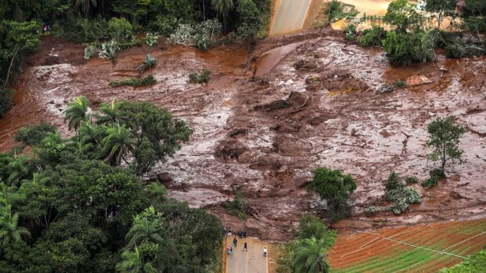
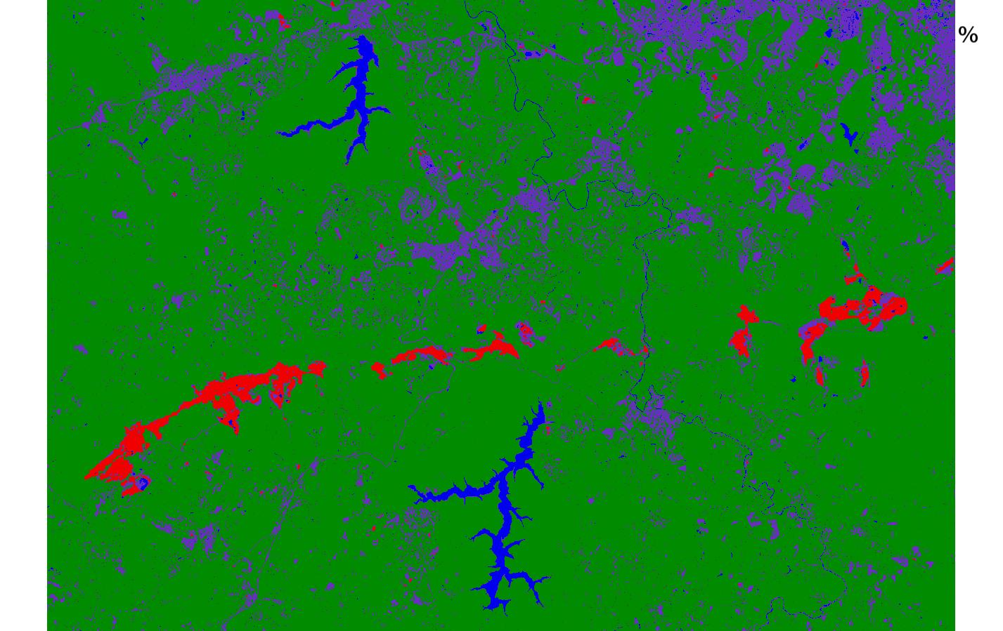
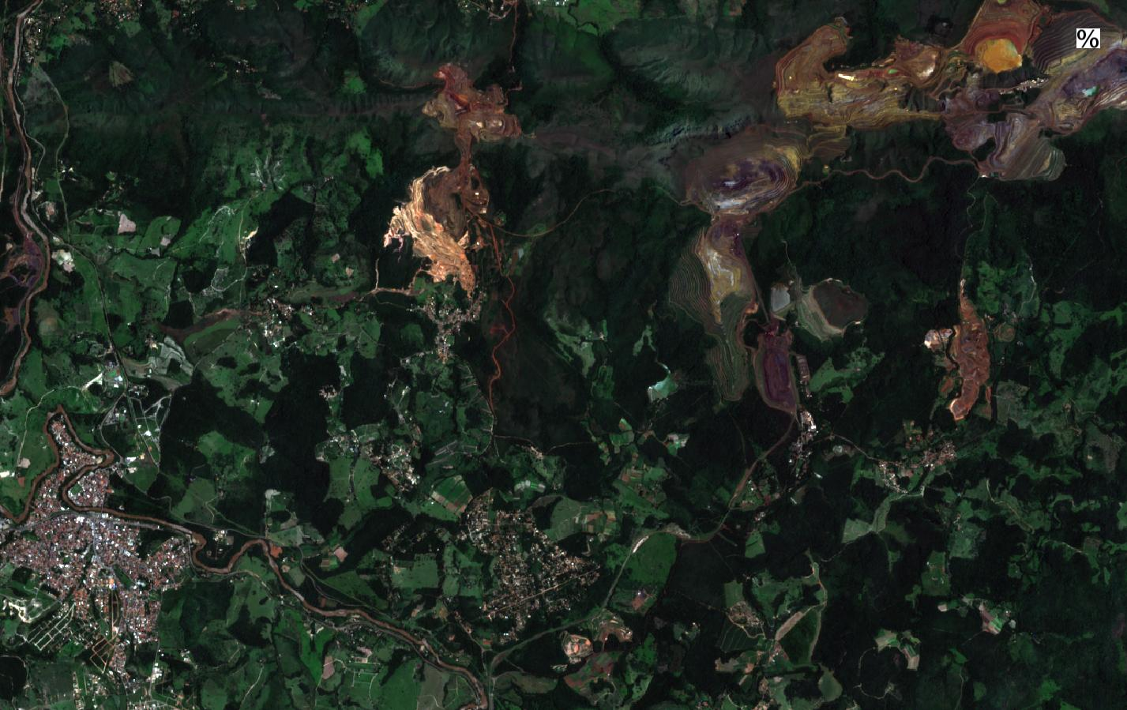
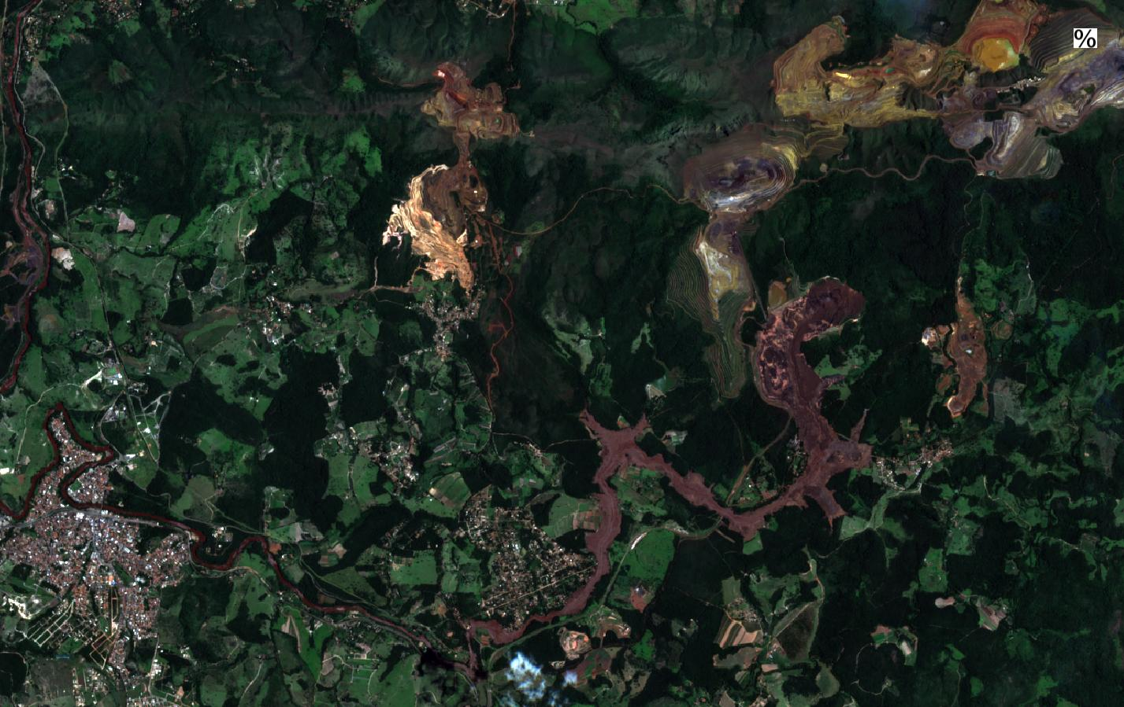
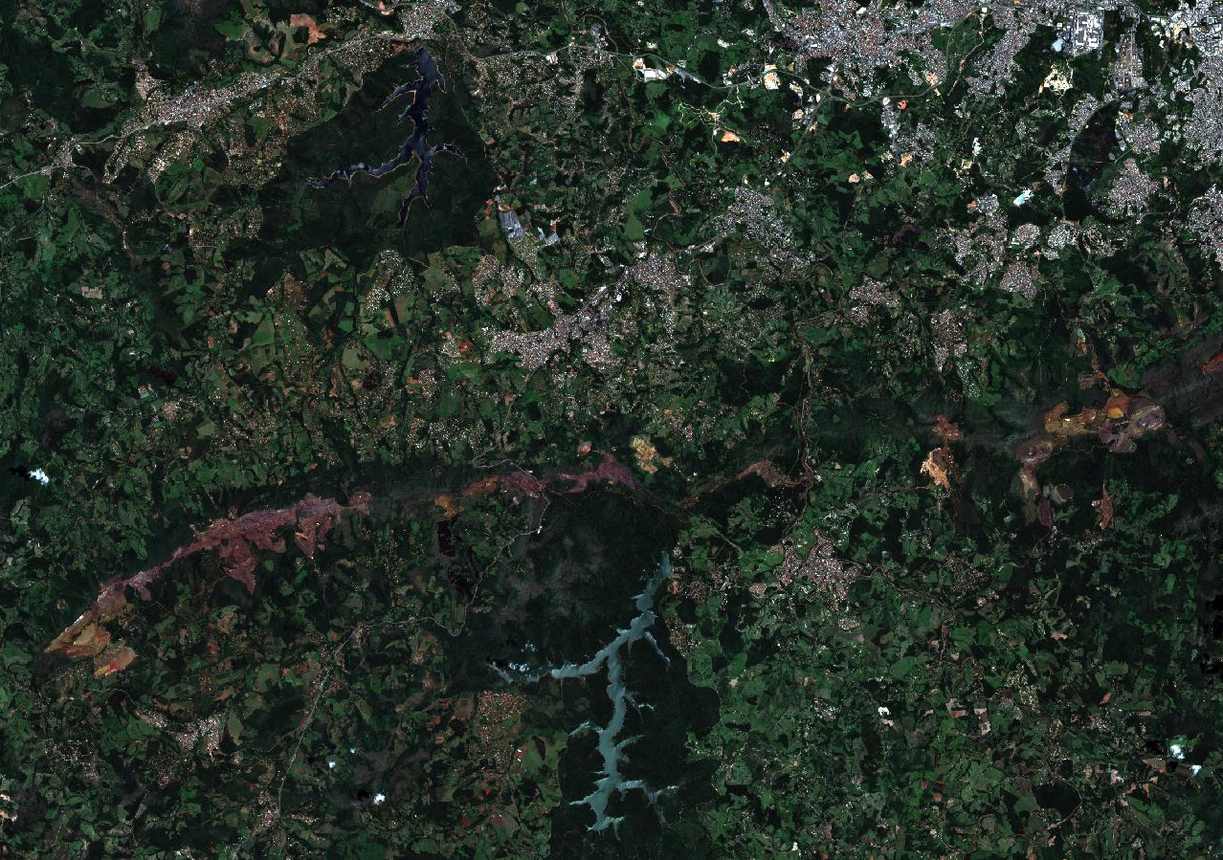
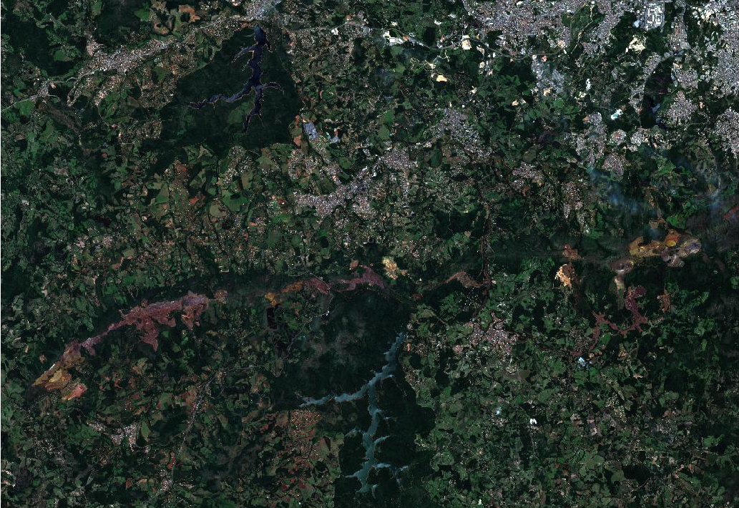
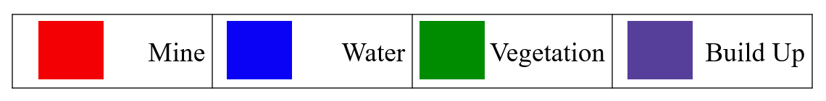
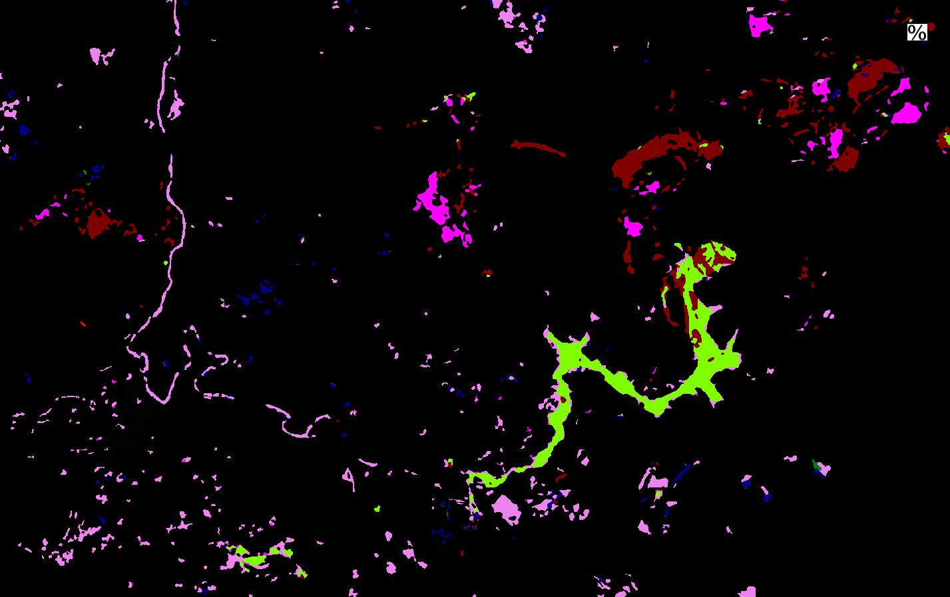
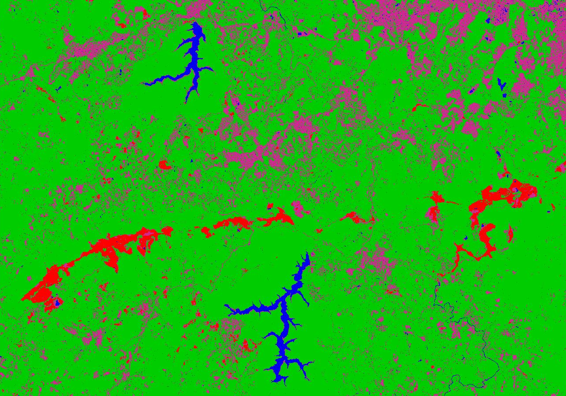
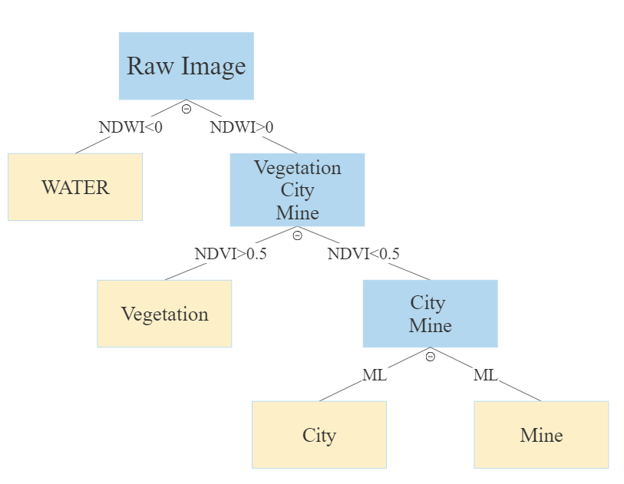
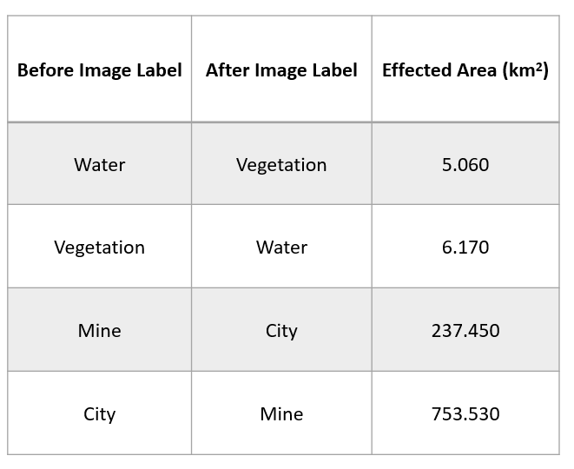
Affected Area Detection with Machine Learning Algorithms of Dam Collapse in Brumadinho, BRAZIL
Merve OLMEZ TURAN, Gurbet G GURKAN, Doga C DEMIRKAN
CU Boulder, Boulder, CO, USA
kh
Results
Introduction
Step III: Classification of Mine and Build Up Area
After completing first two steps, we had only mine and city areas. By training each class and applying Maximum Likelihood which determines the probabilities of classes for each pixel. Then, the label was assigned with respect to the biggest probability of each class.
For before image the accuracy is % and for the after the accuracy is 92.5%.
On January 25th, 2019, an iron mine dam has collapsed in Brumadinho, Brazil. This is the second time in a three years. According to NASA, more than 100 people died in that catastrophic accident. The dam had held back more than 15 million cubic yards of waste material. After the failure, the mud deposits downstream were as thick as 16 feet in some places. More than 290 of people are still missing and extends of the damage is still being calculated, especially in the mining town of Brumadinho, which was buried under mud.
Figure 6. Confusion Matrix for before and after image.
Figure 1. After the Incident
Problem Space
In this study, our aim is to detect the affected area after the disaster with the remote sensing methods and classify the area. Moreover, changes of the area and classes tried to be detected.
Approach
Figure 7. Affected area before and after image.
Figure 4. Before the disaster classification results.
Figure 2. Before (Jan 7th) and after (Feb 1st) images
We download the data from Sentinel-2 database, 18 days prior the disaster and 6 days after the disaster. Then we suggest the following approach shown in Figure 3.
Figure 8. Detection of changed pixels.
Figure 5. After the disaster classification results.
Data
The dataset contains two images from affected area, before and after the disaster generating from Sentinel-2. Each data set has approximately 14.5M pixels, total of 29M pixels. This satellite has 13 bands which means 13 features per entry. Each feature has a value from 0 to 255. The most interesting features include a red, green and infrared band which will help the discrimination of water and vegetation pixels.
By using these images we generated our train and test data sets. Lastly, data visualizations for stress field around the tunnel and the displacement vectors on the tunnel face are included in the simulation. Stresses and the displacements are calculated with a numerical analysis software.
Figure 3. Suggested Approach
Figure 9. Affected area.
Step I: Classification of Water Area
At first, we determine 4 classes, namely, Water, Vegetation, City and Built-up. The water pixels are extracted by the the index method called NDWI. We set the threshold value (<0) to classıfy the water pıxels.
Discussion
This study show the capabilities of Sentinel-2 imagery using in the disasters.
Moreover, machine learning algorithms are sufficiently classify the satellite imagery,
As a future work, we can implement other algorithms and compare the performances.
Step II: Classification of Vegetation Area
We applied threshold (>0.5) for the NDVI index. We named vegetation above the threshold value.

